Slide 1




EXPENSE MANAGEMENT SYSTEM

Slide 2
INTRODUCTION
Simplify expense tracking for individuals and organizations.
Provide detailed insights into spending patterns to enable better financial management.
Offer a platform for users to create, update, and delete expenses and categories.
Generate comprehensive reports based on user-defined time periods and categories.

Slide 3
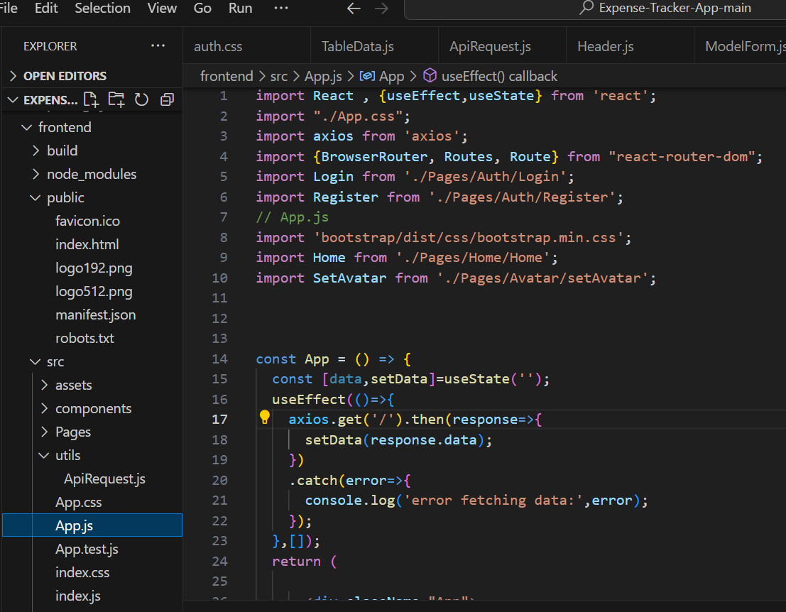
Page 03
Web Tech Used
React.js
Node.js
Express.js
MongoDB

Slide 4
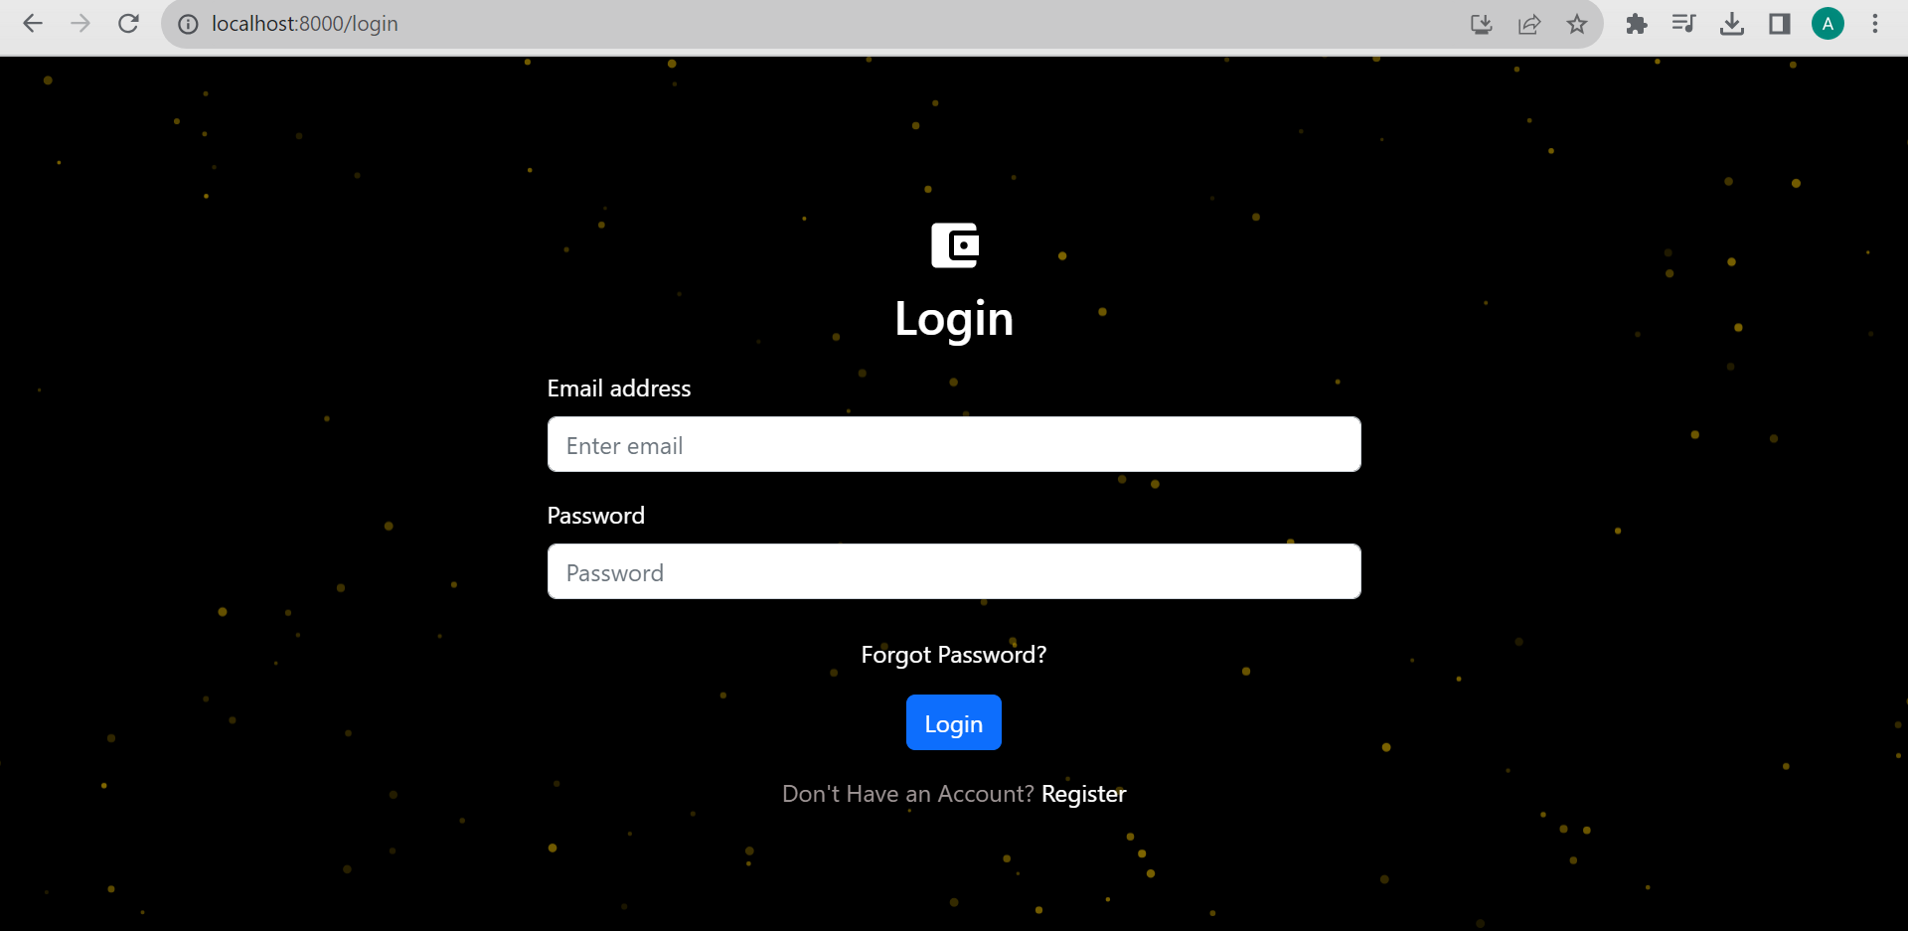
Key features
1.Interactive user interface that is also responsive
20
22

Slide 5
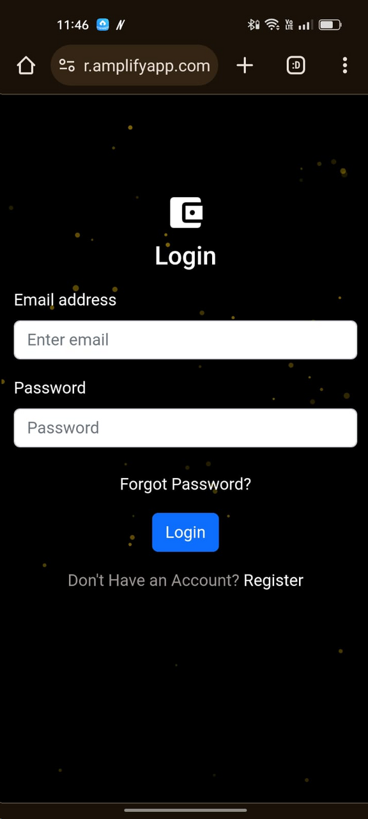

Slide 6
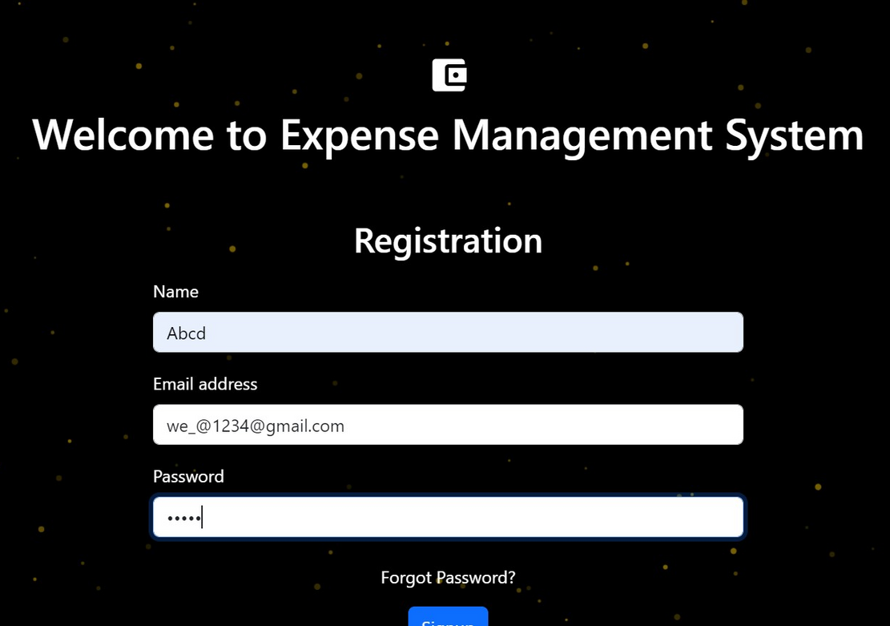
NEW USER REGISTRATION
when a new user register on the System then this page is shown .

Slide 7
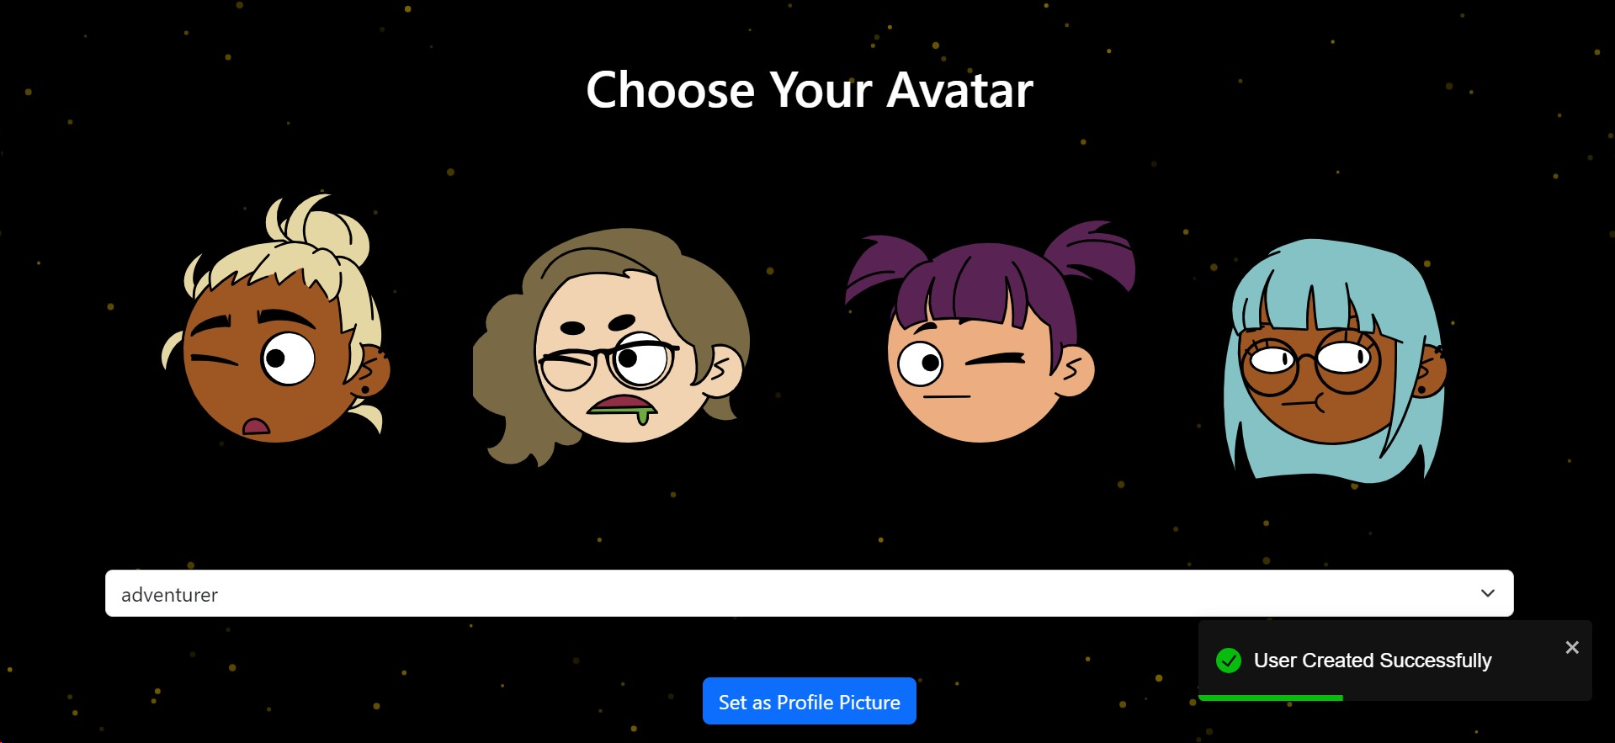
when the user registered then this page is shown with user Created Successfully and have to choose a avtar for profile picture.

Slide 8
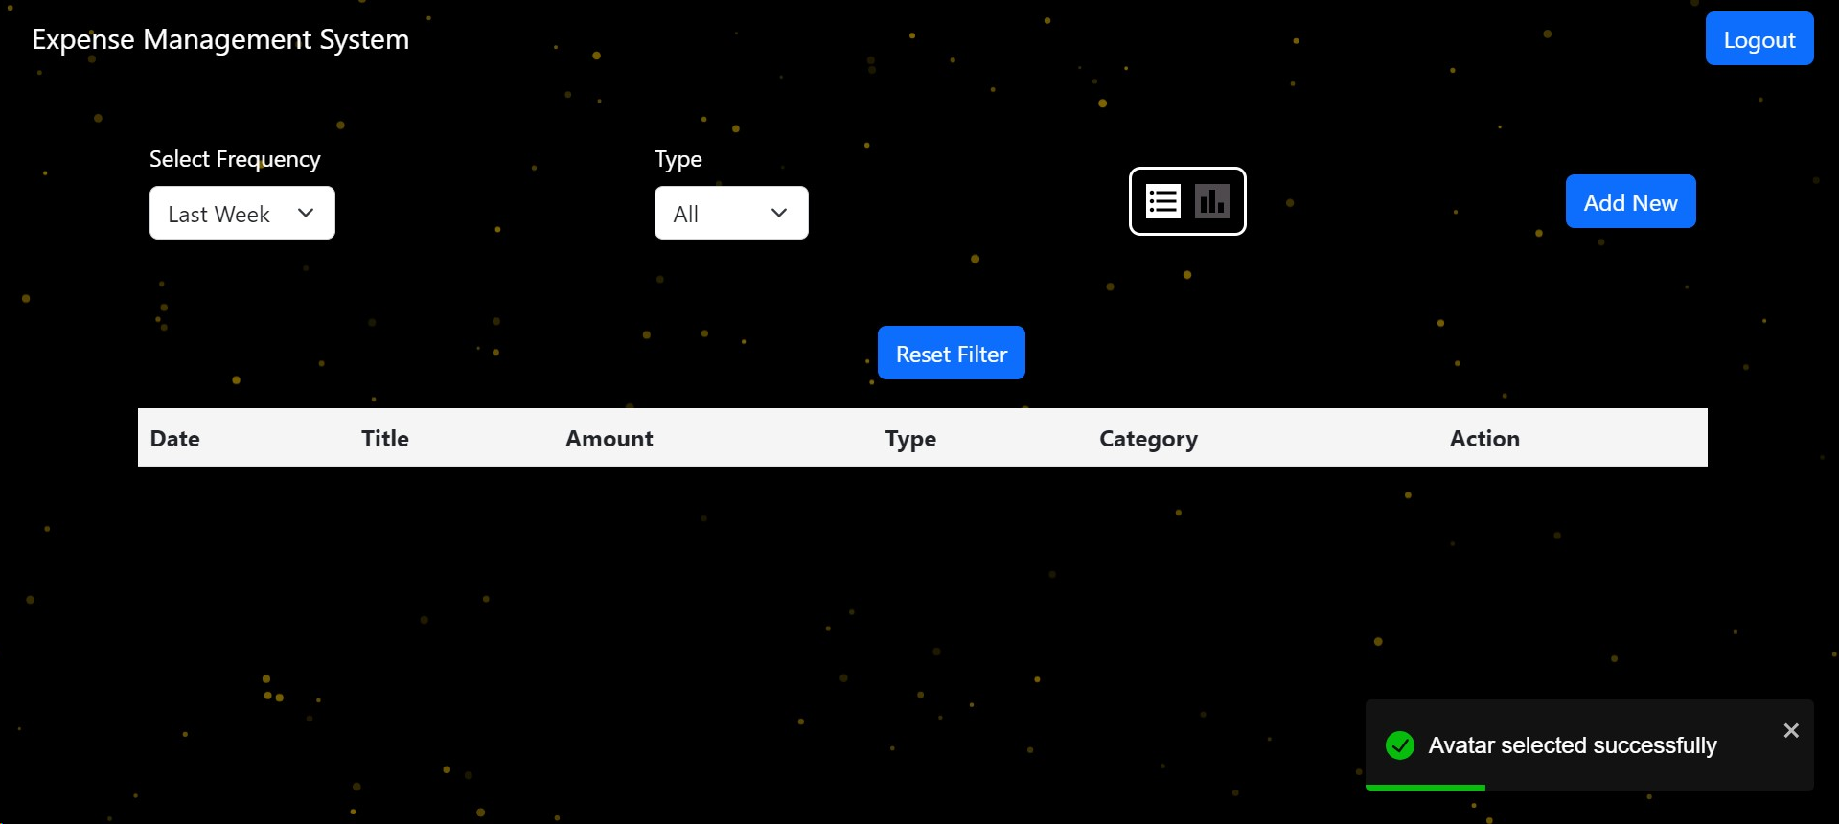
Then after selection of avtar this page is shown to add transaction of details by cliking ion add new button.

Slide 9
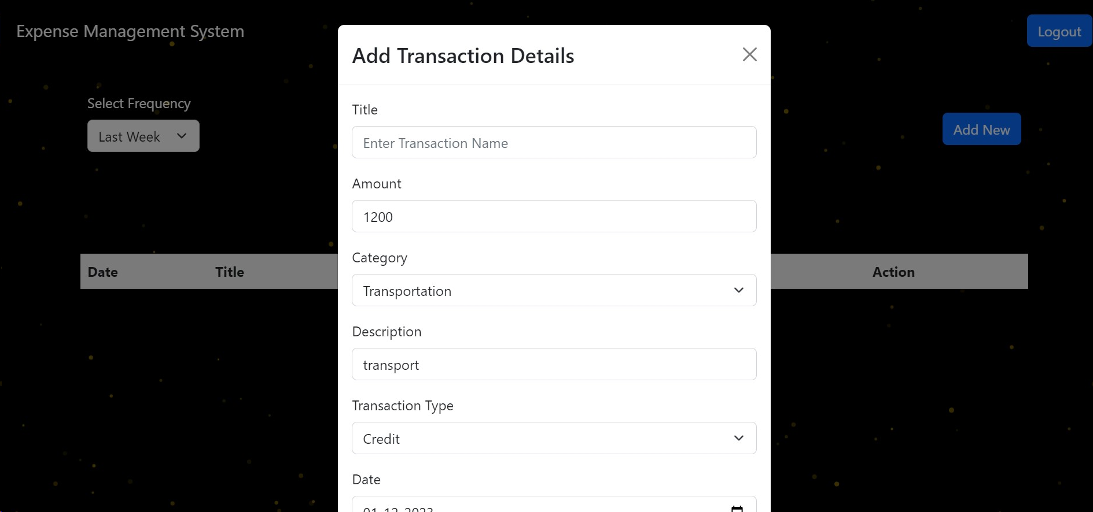
After clicking this will be shown to user and then add transaction details

Slide 10
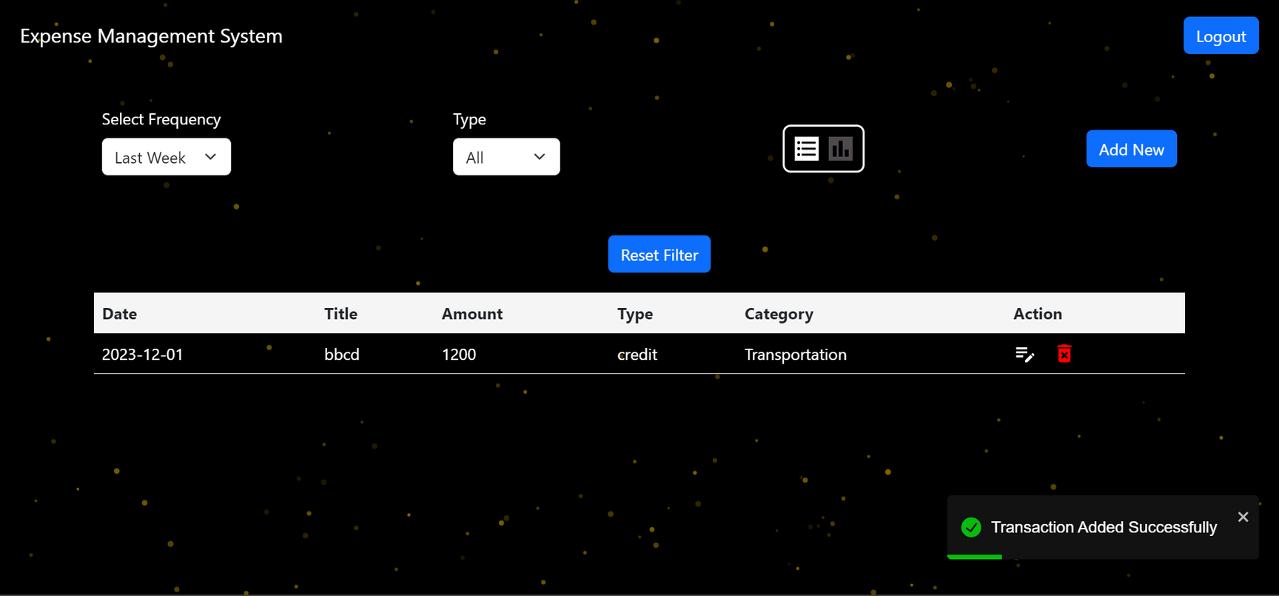
After adding transaction details this will be shown to user with transaction Added Successfully pop up message.

Slide 11
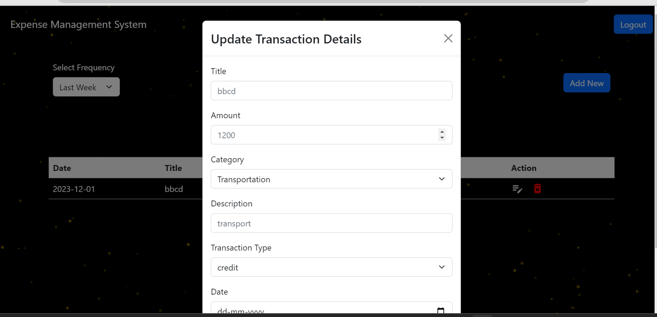
If user want to update details then click under Action Column first Symbol then this form will be shown for updating.

Slide 12
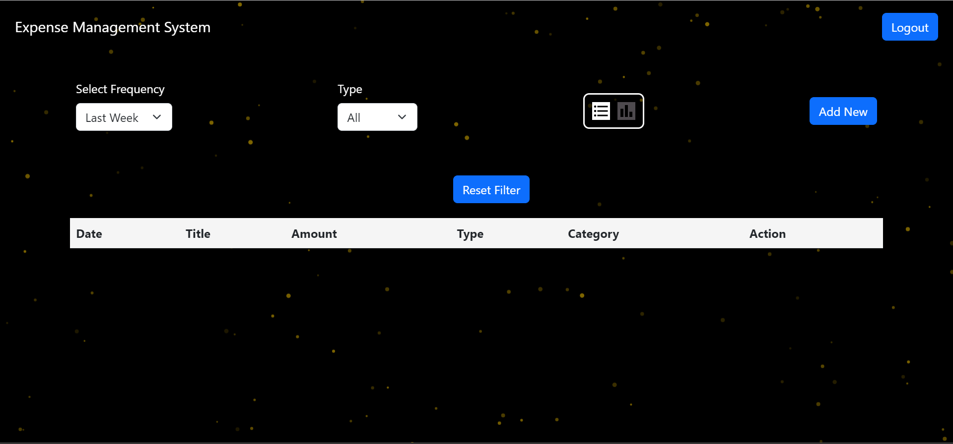
If user want to delete this transaction then click under Action on delete symbol then transaction will be deleted successfully.

Slide 13

ROUTER
Using React-Router-Dom to navigate to another pages or making link to different pages.
Route:Route is the conditionally shown component that renders some
UI when its path matches the current URL
Router:It is the parent component that is used to store all the other components.
Link:The link component is used to create links to different routes and implement navigation around the application .It works like an HTML anchor tag.

Slide 14
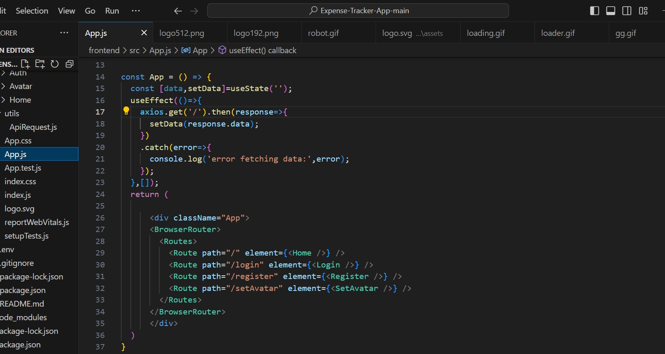

Slide 15
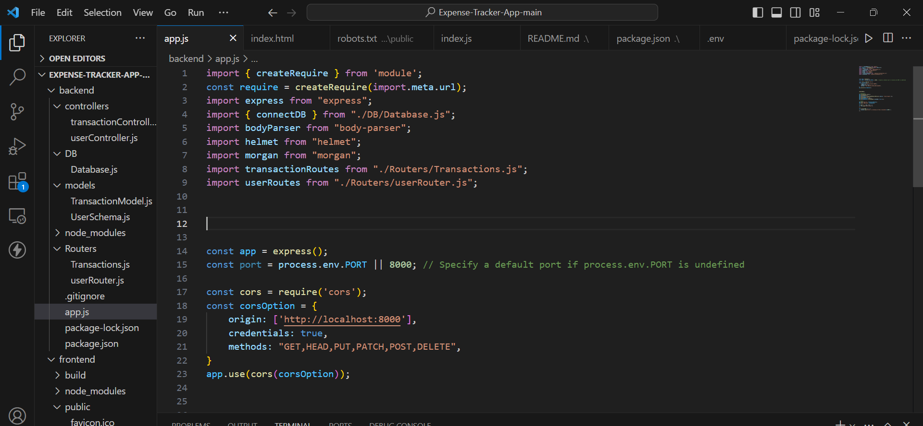
Express
Express is a popular web application framework for Node.js, designed to simplify the process of building
robust and scalable web applications and APIs.
MODULE
A module typically refers to a self-contained and reusable piece of code that encapsulates specific functionality or features of a larger backend application.

Slide 16
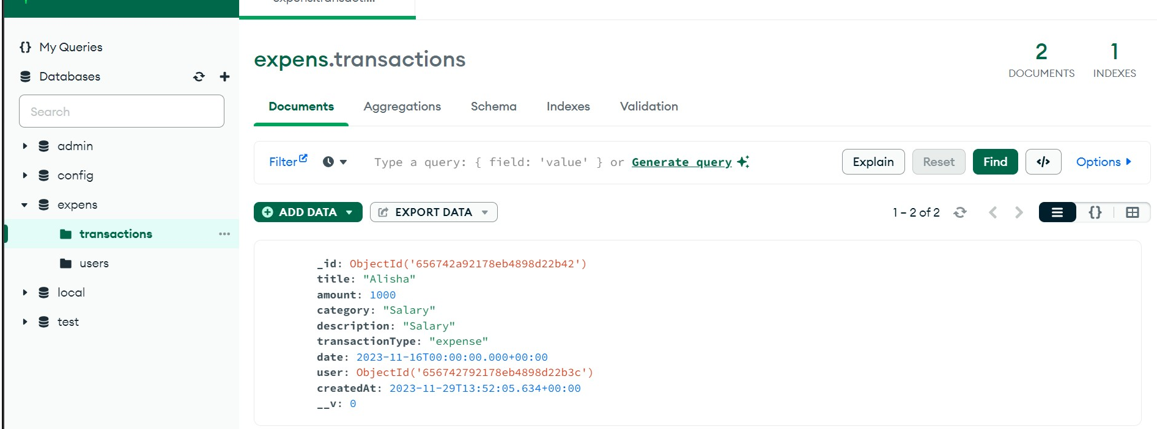
DATABASE
A DATABASE IS A STRUCTURED COLLECTION OF ORGANIZED DATA THAT CAN BE EASILY ACCESSED, MANAGED, AND UPDATED.

Slide 17
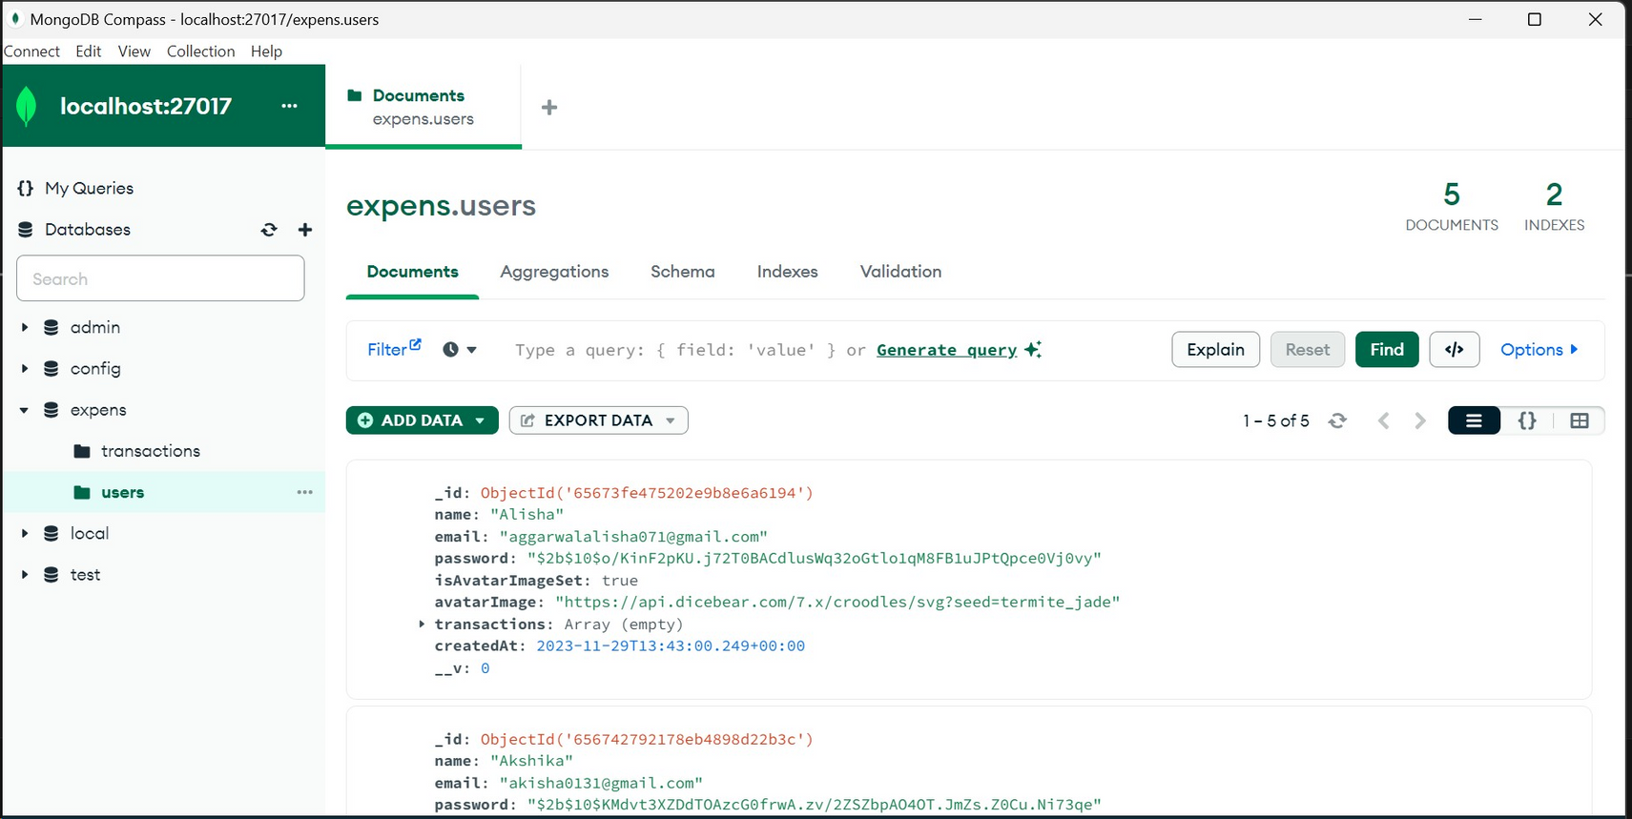

Slide 18
THANK YOU
AAYUSH KATOCH 2110990028
AAYUSH TOMAR 2110990032
ABHIJAY SHARMA 2110990039
ADITYA ARORA 2110990082
AKHILESH STAN 2110990120

